Slide 1
UNIT-II Cryptography-I : Introduction to Cryptography CAP404 INFORMATION SECURITY AND PRIVACY
SCHOOL OF COMPUTER APPLICATIONS
DOMAIN: AI &ML

Slide 2
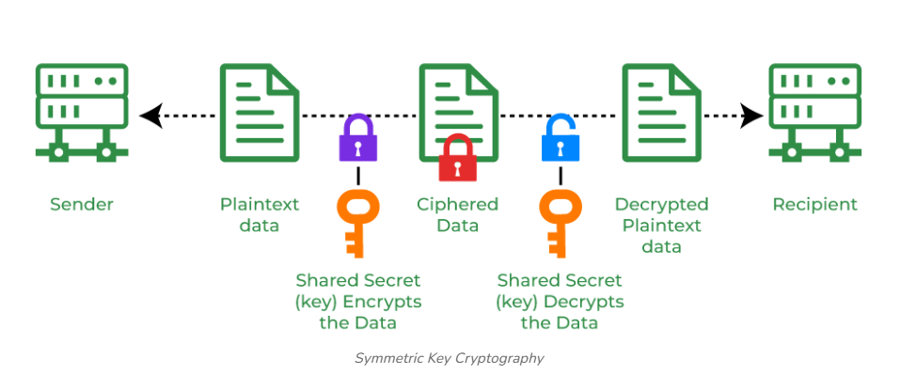
What is a key?

Slide 3
Key size
In cryptography, key size (or key length) is the length of an encryption key measured in bits.
Key Size
Refers to the number of bits (ones and zeros) in the key.
Common symmetric sizes include 128-bit, 192-bit, and 256-bit.
Higher numbers mean stronger protection for data
Why it matters: Larger key size → larger key space → harder to brute-force

Slide 4
Key range
Definition: The total set of all possible key values that can be generated for a given key size (also called the "key space")
Formula: Key Range = 2ⁿ, where n = key size in bits
Examples:
8-bit key → 2⁸ = 256 possible keys
56-bit key (DES) → 2⁵⁶ ≈ 7.2 × 10¹⁶ possible keys
128-bit key (AES) → 2¹²⁸ ≈ 3.4 × 10³⁸ possible keys

Slide 5
Key Size Impact in Brute Force Attack
Assuming that the algorithm is just perfect by perfect we mean that there is no way to break the cryptosystem other than performing the brute-force attack.
Calculating the complexity of a brute force attack is easy, if the length of the key is 8 bits then there will be 256 possible keys.
This implies it will take only 256 attempts to crack the correct key.
Similarly, if the key is 56 bits long then it would take 2^256 that is it will take 2285 years in finding the correct key.

Slide 6
Key Size | Key Range | Approx. Time to Brute-Force
40-bit | 2⁴⁰ | ~18 minutes
56-bit (DES) | 2⁵⁶ | ~2,285 years
64-bit | 2⁶⁴ | ~584,542 years
128-bit (AES) | 2¹²⁸ | Billions of years (longer than age of universe)

Slide 7
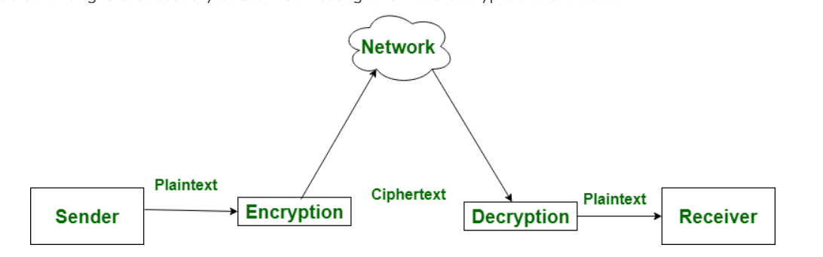
Difference between Encryption and Decryption

Slide 8
What is Encryption?
Data can be secured with encryption by being changed into an unintelligible format that can only be interpreted by a person with the proper decryption key. Sensitive data, including financial and personal information as well as communications over the internet, is frequently protected with it.
Application of Encryption
Online Banking: To secure transactions, use online banking.
Email security: To safeguard the contents of emails.
Secure Messaging: To protect the privacy of discussions.
Data Storage: To prevent unwanted access to data that has been stored.

Slide 9
What is Decryption?
To make encrypted data comprehensible again, it must first be decrypted and then put back into its original format. To access and utilize the protected information, authorized parties must follow this procedure.
Real-Life Examples of Encryption and Decryption
WhatsApp Messaging: It encrypts It encrypts communications from beginning to end so that only the sender and recipient can read them.
HTTPS websites: Encrypt user data to prevent third parties from intercepting it.
Encrypted Email Services: Email services that use encryption, like ProtonMail, protect email contents.

Slide 10
Encryption | Decryption
Encryption is the process of converting a normal message into a meaningless message. | While decryption is the process of converting meaningless messages into their original form,.
Encryption is the process that takes place at the sender's end. | While decryption is the process that takes place at the receiver's end,.
Its major task is to convert the plain text into cipher text. | While its main task is to convert the cipher text into plain text,.
Any message can be encrypted with either a secret key or a public key. | Whereas the encrypted message can be decrypted with either a secret key or a private key,.
In the encryption process, the sender sends the data to the receiver after encrypting it. | Whereas in the decryption process, the receiver receives the information (cipher text) and converts it into plain text.

Slide 11
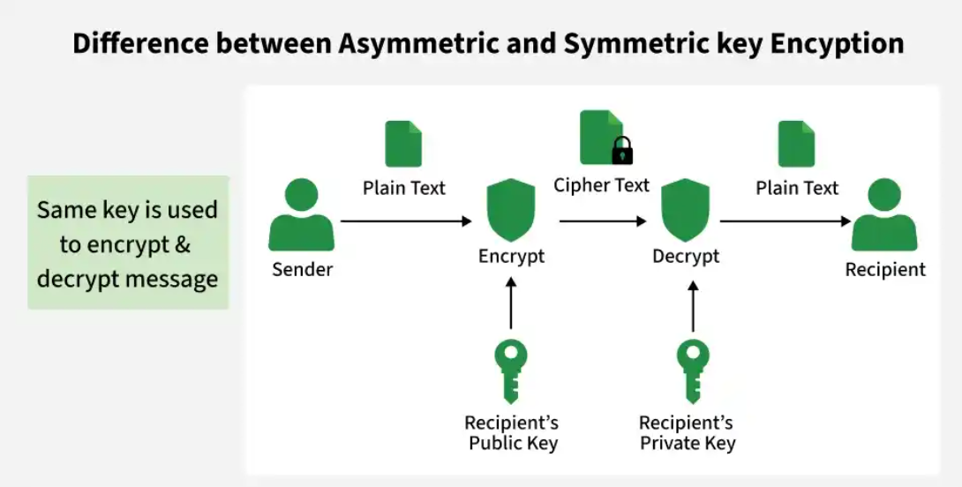
Difference Between Symmetric and Asymmetric Key Encryption

Slide 12
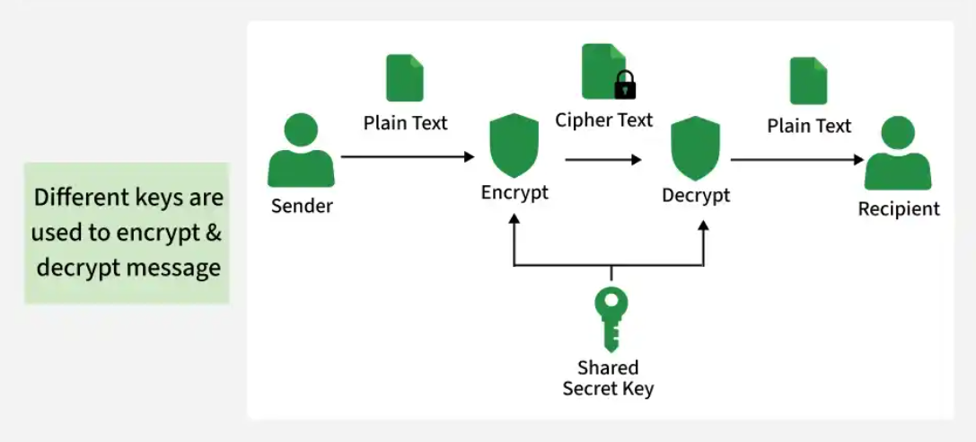
Asymmetric Key Encryption

Slide 13
Symmetric Key Cryptography — The Logic
Core idea: One single shared secret key performs both encryption and decryption
Mathematical logic: Uses reversible operations (substitution, permutation, XOR) that can be undone with the same key
Encryption: Ciphertext = E(Plaintext, Key)
Decryption: Plaintext = D(Ciphertext, Key) — same Key used both ways
Symmetric Key — Real-Life Examples
WhatsApp/Signal message encryption: Once a chat session is established, actual messages are encrypted with a symmetric key (fast enough for real-time chat)
Wi-Fi security :Your router and devices share a pre-agreed password-derived key to encrypt all traffic on the network
File encryption (BitLocker): You set one password/key to lock and unlock your hard drive — same key both ways

Slide 14
Asymmetric Key Cryptography — The Logic
Core idea: Uses a mathematically linked key pair — a public key and a private key — where one encrypts and only the other can decrypt
Mathematical logic: Built on one-way (trapdoor) functions — easy to compute in one direction, practically impossible to reverse without a secret "trapdoor"
Example : Multiplying two large primes is easy; factoring their product back into the original primes is computationally infeasible
How the pair works:
Public key → derived from the private key using a trapdoor function, safe to share openly
Private key → kept secret, mathematically required to reverse what the public key encrypted
Ciphertext = E(Plaintext, PublicKey) → Plaintext = D(Ciphertext, PrivateKey)

Slide 15
Asymmetric Key Cryptography — The Logic
Asymmetric Key — Real-Life Examples
HTTPS/SSL padlock in your browser
Sending someone your bank details securely
Digital signatures on documents (Adobe Sign, DocuSign)
Cryptocurrency wallets (Bitcoin, Ethereum)

Slide 16
RSA Asymmetric cryptographic algorithm
RSA stands for Rivest, Shamir, and Adleman. It is a widely used public-key encryption and digital signature algorithm named after its tKey Facts About RSA
Inventors: Ron Rivest, Adi Shamir, and Leonard Adleman.
Type: Asymmetric cryptography (uses a public key to encrypt and a private key to decrypt).
Use Case: Secure data transmission, digital signatures, and web traffic safety (TLS/SSL).
Core Principle: Relies on the extreme difficulty of factoring the product of two very large prime numbers
hree inventors who published it in 1977.

Slide 17
The 5 Simple Steps (RSA Key Creation)
Step 1: Pick 2 secret prime numbers
p = 7
q = 13
Step 2: Multiply them → this becomes your Public Key part
n = 7 × 13 = 91
Step 3: Do a small calculation on p and q → SECRET number
φ = (7−1) × (13−1) = 6 × 12 = 72
(Only YOU can do this step, because only you know 7 and 13 separately)

Slide 18
Cont.
Step 4: Pick a small public number e
e = 5
(Any number that doesn't divide evenly into 72)
→ PUBLIC KEY = (91, 5) — share this with everyone
Step 5: Find a partner number d for e → your Private Key
d = 29

Slide 19
Cont.
(The one number that makes 5 × 29 leave remainder 1 when divided by 72)
→ PRIVATE KEY = (91, 29) — keep this secret forever

Slide 20
What the Receiver Knows (Full Picture)
The receiver is the one who generated the keys — so they know everything:
p = 7 ← secret prime
q = 13 ← secret prime
n = 91 ← public (shared)
φ = 72 ← secret helper number
e = 5 ← public (shared)
d = 29 ← PRIVATE KEY (never shared)

